Slide 1




















FRUIT ONLINE
STORE
Greeny Shop

Slide 2


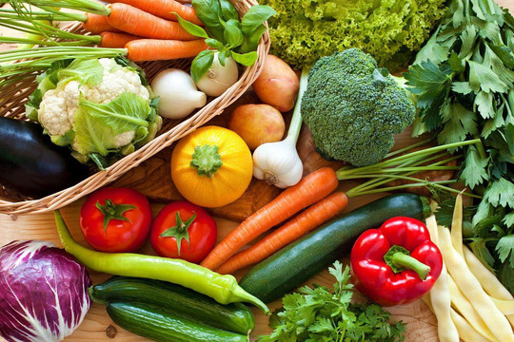


HELLO, EVERYONE!
Group leader: Lê Hồng Quang
Members: - Lê Thế Duyệt
- Hồ Dũng
- Nguyễn Hoàng Đạt

Slide 3






WELCOME
Fresh fruits are a crucial part of a healthy lifestyle and their consumption has gained immense popularity in recent years. The increasing demand for fresh and high-quality fruits has led to the appearance of online fruit trading platforms. Nowadays, consumers prefer buying fruits online as it offers them convenience and a wide variety of choices. However, the lack of a reliable, efficient, and affordable fruit trading service has opened the opportunity for the new fruit-selling website - Greeny

Slide 4



CONTENTS:
1. Project scope
2. System Design
3. Applied technology
4. Future Work
5. Demo
6. Questions and answers
7. References

Slide 5





PROJECT SCOPE
1
A user-friendly interface with clear navigation that allows customers to easily browse and purchase products.
2
Detailed product information, including product descriptions, images, and nutritional information.
Multiple payment options, including credit/debit cards, digital wallets, and other digital payment methods.
3
An automated order management system that allows for efficient order fulfillment and tracking.
4
Integration with social media platforms to increase the store's online presence and reach
5

Slide 6


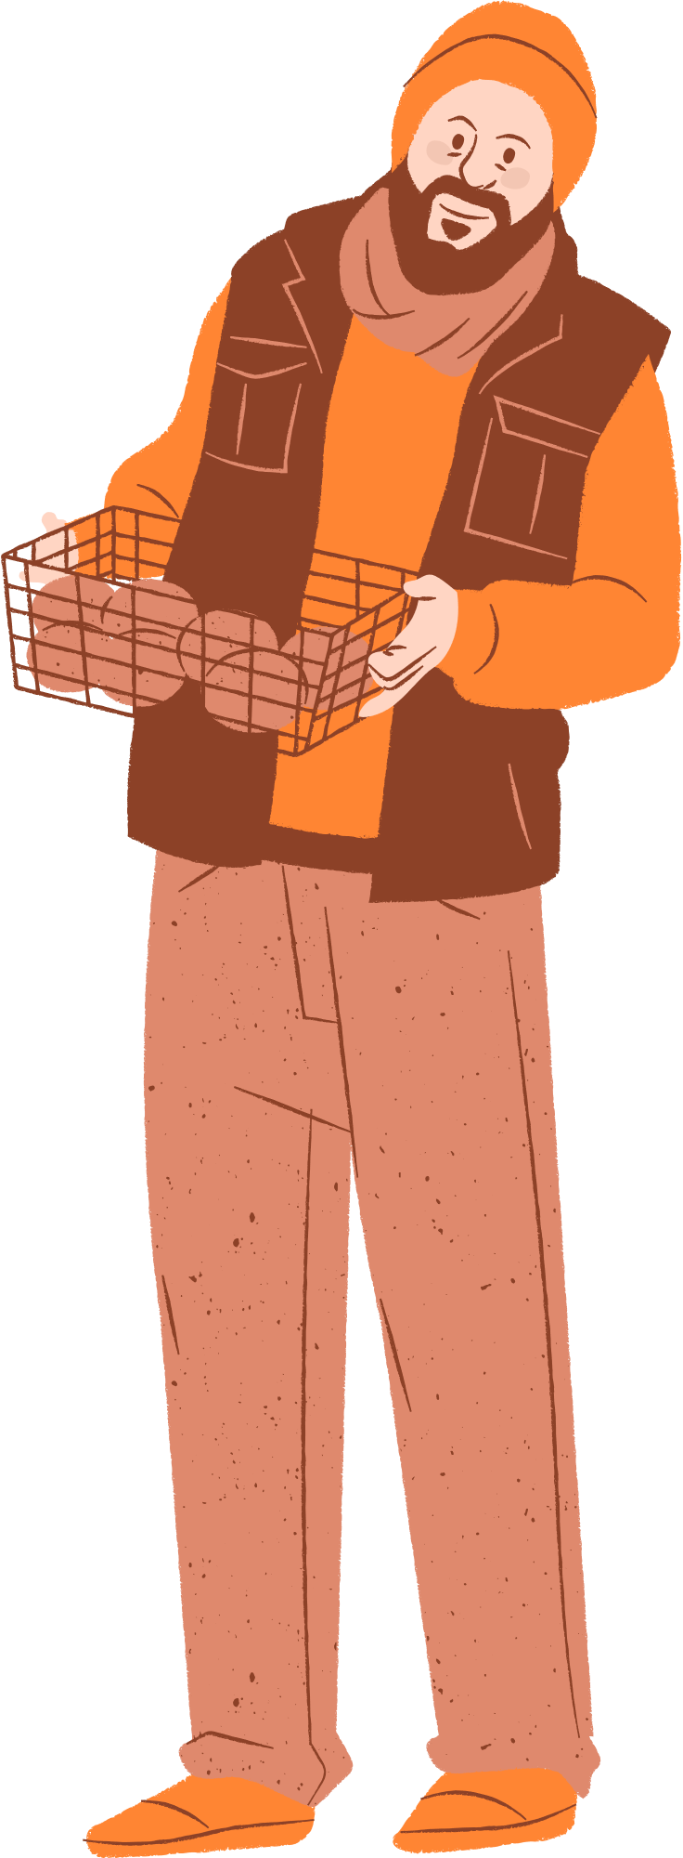
SYSTEM DESIGN

Slide 7
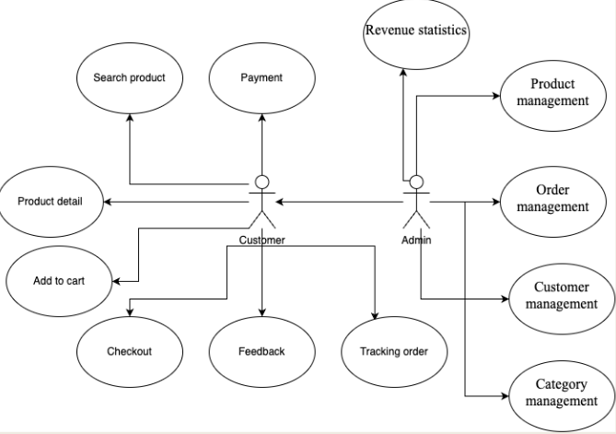


USE CASE DIAGRAM

Slide 8
USE CASE DIAGRAM
Functions of customer
Search
Product information
Add to cart
Checkout
Payment processing
Shipping and tracking
Review and feedback
Functions of Administrator
Category management
Product management
Customer management
Order management
Revenue statistics

Slide 9
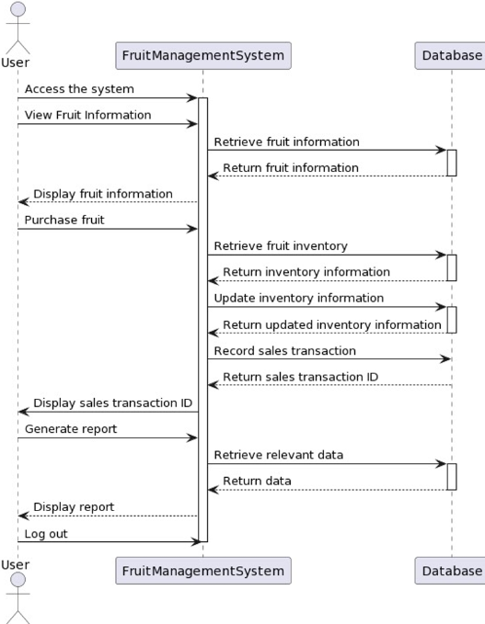

SEQUENCE
DIAGRAM

Slide 10
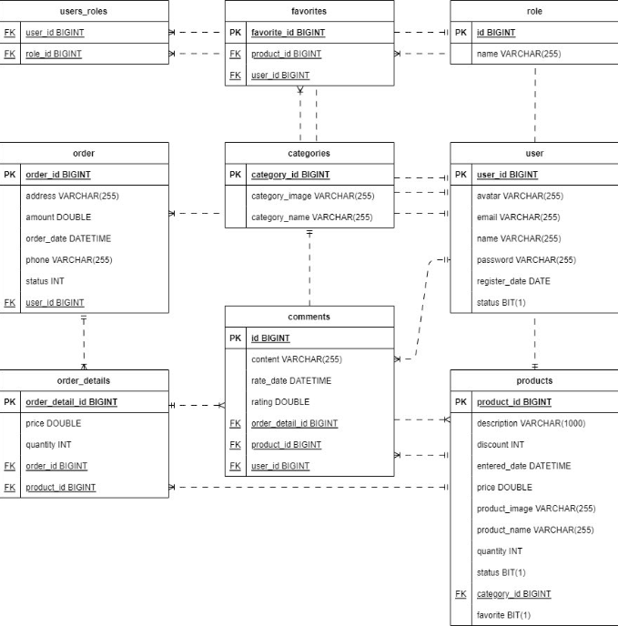
ER
DIAGRAM

Slide 11
APPLIED TECHNOLOGY
Java
HTML/CSS
Springboot

Slide 12
FUTURE WORK

Slide 13
PROJECT SCOPE
Implementing a recommendation engine that suggests products based on a customer's browsing behavior or purchase history can increase sales and improve customer satisfaction.
1
As more and more customers are using smartphones to shop online, comprehensive optimization for mobile devices is essential such as implementing a responsive design and easy-to-use navigation bar.
2
Expanding the range of the products sold on the website may draw attention to many potential customers and increase revenue.
3
Encouraging customers to leave their reviews, feedback and share to social platforms by awarding them discounts for future purchases
4

Slide 14
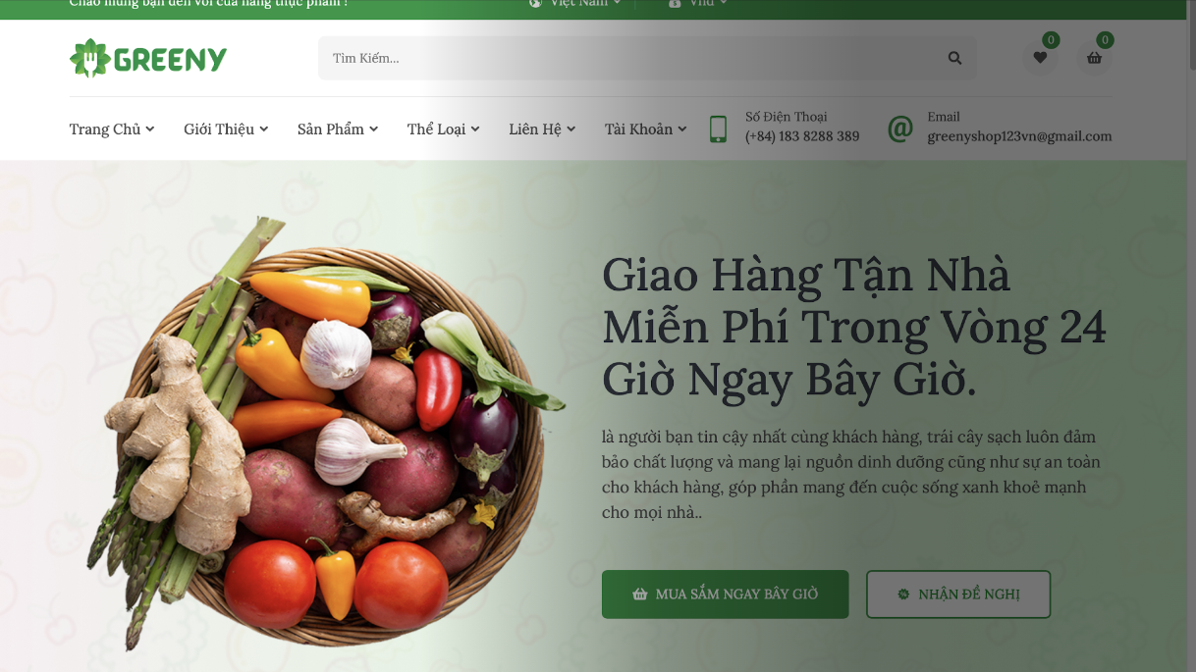
DEMO

Slide 15




ANY QUESTIONS?
Encourage the audience to ask questions, provide feedback, share their insights, etc.

Slide 16
REFERENCES
MARTY HALL, LARRY BROWN “Core Servlets and JavaServer Pages™ - Volume 1 Core Technologies”, Second Edition, 2003.
MARTY HALL, LARRY BROWN “Core Web Programming”, Second Edition, 2001.
DAVE CRANE, ERIC PASCARILLO, DARREN JAMES, “Ajax in Action”, 2006.
JAMES L. WEAVER, KEVIN MUKHAR, AND JIM CRUME, “Beginning J2EE 1.4: From Novice to Professional”, 2004.
https://www.javatpoint.com/spring-tutorial
https://www.w3schools.com/js/default.asp
https://www.w3schools.com/bootstrap/bootstrap_get_started.asp

Slide 17
THANK YOU FOR WATCHING!
Feel free to reach out to us through any of the following:
WEBSITE:
EMAIL:
greenyshop.com
webproject@gmail.com
Facebook:
Greeny-shop fruit

